Slide 1
Distances, Trees, and Types: Methods for Analyzing High-Dimensional Microbiome Data
Brendan J. Kelly, MD, MSCE
Division of Infectious Diseases
University of Pennsylvania
2 June 2022

Slide 2
Outline
The problem: too much data.
Reducing dimensions:
richness, evenness, and diversity
ecological distances (UniFrac)
PCA & PCoA
PERMANOVA (adonis)
Cluster analysis:
supervised vs unsupervised learning
Dirichlet multinomial mixture modeling

Slide 3
Outline
The problem: too much data.
Reducing dimensions:
richness, evenness, and diversity
ecological distances (UniFrac)
PCA & PCoA
PERMANOVA (adonis)
Cluster analysis:
supervised vs unsupervised learning
Dirichlet multinomial mixture modeling

Slide 4
Generating Microbiome Data
High-density (next-generation, high-throughput) sequencing:
“tag” gene with conserved and variable regions (16S, 18S, ITS)
“shotgun” metagenomics (pool of randomly amplified nucleic acid)
Sequence binning and assignment:
operational taxonomic units (OTUs) based on 97% sequence similarity → taxonomic assignment of OTUs
assemble contiguous metagenomic sequences → taxonomy
unassembled reads → taxonomic assignment
Callahan BJ bioArxiv 2017.

Slide 5
 | Stool_1 | Stool_2 | Stool_3 | Stool_4 | Stool_5 | Stool_6 | Stool_7 | Stool_8 | Stool_9 | Stool_10 | Stool_11 | Stool_12 | Stool_13 | Stool_14 | Stool_15 | Stool_16
OTU_97.10 | 0 | 0 | 0 | 0 | 0 | 0 | 0 | 0 | 0 | 0 | 0 | 0 | 0 | 0 | 0 | 0
OTU_97.10002 | 0 | 0 | 0 | 0 | 0 | 0 | 0 | 0 | 0 | 4 | 0 | 0 | 0 | 0 | 9 | 0
OTU_97.10005 | 0 | 0 | 0 | 0 | 0 | 0 | 0 | 0 | 0 | 0 | 0 | 0 | 0 | 0 | 0 | 0
OTU_97.10008 | 0 | 1 | 0 | 0 | 0 | 0 | 1 | 0 | 1 | 5 | 3 | 1 | 0 | 0 | 1 | 0
OTU_97.10010 | 0 | 0 | 0 | 0 | 0 | 0 | 0 | 0 | 0 | 0 | 0 | 0 | 0 | 0 | 0 | 0
OTU_97.10016 | 0 | 0 | 0 | 0 | 0 | 0 | 0 | 0 | 0 | 0 | 0 | 0 | 0 | 0 | 0 | 0
OTU_97.10018 | 0 | 0 | 0 | 0 | 0 | 0 | 0 | 0 | 0 | 0 | 0 | 0 | 0 | 0 | 0 | 0
OTU_97.10029 | 4 | 12 | 0 | 0 | 0 | 0 | 1 | 0 | 0 | 0 | 0 | 1 | 0 | 6 | 3 | 0
OTU_97.10034 | 0 | 3 | 0 | 0 | 0 | 0 | 0 | 0 | 0 | 1 | 0 | 2 | 0 | 0 | 3 | 0
OTU_97.10035 | 0 | 0 | 0 | 0 | 0 | 0 | 0 | 0 | 0 | 0 | 2 | 0 | 0 | 0 | 2 | 0
OTU_97.10037 | 0 | 0 | 0 | 0 | 0 | 0 | 0 | 0 | 0 | 0 | 0 | 2 | 0 | 0 | 0 | 0
OTU_97.10039 | 0 | 0 | 0 | 0 | 0 | 0 | 0 | 0 | 0 | 0 | 0 | 0 | 0 | 0 | 0 | 0
OTU_97.10048 | 0 | 1 | 0 | 0 | 0 | 0 | 0 | 0 | 0 | 0 | 0 | 0 | 0 | 0 | 0 | 0
OTU_97.10057 | 0 | 0 | 2 | 0 | 0 | 0 | 0 | 0 | 0 | 0 | 0 | 1 | 0 | 5 | 0 | 1
OTU_97.10058 | 0 | 0 | 0 | 0 | 0 | 0 | 0 | 0 | 0 | 0 | 0 | 0 | 0 | 0 | 0 | 0
OTU_97.10059 | 0 | 0 | 0 | 0 | 0 | 0 | 4 | 0 | 0 | 0 | 0 | 0 | 0 | 12 | 0 | 0
8048 ROWS - 187 COLUMNS
OTU_97.9518 | 0 | 0 | 0 | 0 | 0 | 0 | 0 | 0 | 0 | 0 | 1 | 0 | 0 | 0 | 0 | 0
OTU_97.9523 | 0 | 0 | 0 | 0 | 0 | 0 | 0 | 0 | 0 | 0 | 0 | 8 | 0 | 0 | 0 | 0
OTU_97.9535 | 0 | 0 | 0 | 0 | 0 | 0 | 1 | 0 | 0 | 0 | 107 | 0 | 2 | 3 | 12 | 0
OTU_97.9540 | 0 | 0 | 0 | 0 | 0 | 0 | 0 | 0 | 0 | 0 | 0 | 0 | 0 | 0 | 0 | 0
OTU_97.9546 | 0 | 0 | 1 | 0 | 0 | 1 | 0 | 0 | 0 | 0 | 0 | 0 | 0 | 0 | 0 | 0
OTU_97.956 | 0 | 0 | 2 | 12 | 0 | 7 | 0 | 0 | 0 | 0 | 0 | 7 | 1 | 0 | 0 | 0
OTU_97.957 | 0 | 0 | 0 | 0 | 0 | 0 | 0 | 0 | 0 | 0 | 0 | 0 | 0 | 0 | 0 | 0
OTU_97.9572 | 0 | 1 | 0 | 1 | 0 | 0 | 4 | 0 | 0 | 3 | 0 | 0 | 0 | 0 | 0 | 0
OTU_97.9583 | 0 | 0 | 0 | 0 | 2 | 0 | 0 | 1 | 0 | 0 | 0 | 11 | 0 | 6 | 0 | 0
OTU_97.9588 | 0 | 0 | 0 | 0 | 0 | 0 | 0 | 0 | 0 | 0 | 0 | 0 | 0 | 0 | 0 | 0
OTU_97.9591 | 0 | 0 | 0 | 0 | 0 | 0 | 22 | 0 | 0 | 0 | 0 | 0 | 0 | 0 | 0 | 0
OTU_97.9593 | 0 | 0 | 0 | 0 | 0 | 0 | 0 | 0 | 0 | 0 | 0 | 0 | 0 | 0 | 0 | 0
OTU_97.9594 | 0 | 0 | 0 | 0 | 0 | 0 | 0 | 0 | 0 | 0 | 0 | 0 | 0 | 0 | 0 | 0
OTU_97.96 | 0 | 11 | 0 | 0 | 0 | 0 | 0 | 0 | 0 | 0 | 0 | 0 | 0 | 1 | 0 | 0
OTU_97.9600 | 0 | 0 | 0 | 2 | 0 | 0 | 1 | 0 | 0 | 0 | 2 | 0 | 0 | 0 | 0 | 0
OTU_97.9605 | 0 | 0 | 0 | 0 | 0 | 0 | 0 | 0 | 0 | 0 | 0 | 0 | 0 | 0 | 0 | 0

Slide 6
 | OTU_97.10 | OTU_97.10002 | OTU_97.10005 | OTU_97.10008 | OTU_97.10010 | OTU_97.10016 | OTU_97.10018 | OTU_97.10029 | OTU_97.10034 | OTU_97.10035 | OTU_97.10037 | OTU_97.10039 | OTU_97.10048 | OTU_97.10057 | OTU_97.10058 | OTU_97.10059 | 187 ROWS - 8048 COLS | OTU_97.9518 | OTU_97.9523 | OTU_97.9535 | OTU_97.9540 | OTU_97.9546 | OTU_97.956 | OTU_97.957 | OTU_97.9572 | OTU_97.9583 | OTU_97.9588
Stool_1 | 0 | 0 | 0 | 0 | 0 | 0 | 0 | 4 | 0 | 0 | 0 | 0 | 0 | 0 | 0 | 0 |  | 0 | 0 | 0 | 0 | 0 | 0 | 0 | 0 | 0 | 0
Stool_2 | 0 | 0 | 0 | 1 | 0 | 0 | 0 | 12 | 3 | 0 | 0 | 0 | 1 | 0 | 0 | 0 |  | 0 | 0 | 0 | 0 | 0 | 0 | 0 | 1 | 0 | 0
Stool_3 | 0 | 0 | 0 | 0 | 0 | 0 | 0 | 0 | 0 | 0 | 0 | 0 | 0 | 2 | 0 | 0 |  | 0 | 0 | 0 | 0 | 1 | 2 | 0 | 0 | 0 | 0
Stool_4 | 0 | 0 | 0 | 0 | 0 | 0 | 0 | 0 | 0 | 0 | 0 | 0 | 0 | 0 | 0 | 0 |  | 0 | 0 | 0 | 0 | 0 | 12 | 0 | 1 | 0 | 0
Stool_5 | 0 | 0 | 0 | 0 | 0 | 0 | 0 | 0 | 0 | 0 | 0 | 0 | 0 | 0 | 0 | 0 |  | 0 | 0 | 0 | 0 | 0 | 0 | 0 | 0 | 2 | 0
Stool_6 | 0 | 0 | 0 | 0 | 0 | 0 | 0 | 0 | 0 | 0 | 0 | 0 | 0 | 0 | 0 | 0 |  | 0 | 0 | 0 | 0 | 1 | 7 | 0 | 0 | 0 | 0
Stool_7 | 0 | 0 | 0 | 1 | 0 | 0 | 0 | 1 | 0 | 0 | 0 | 0 | 0 | 0 | 0 | 4 |  | 0 | 0 | 1 | 0 | 0 | 0 | 0 | 4 | 0 | 0
Stool_8 | 0 | 0 | 0 | 0 | 0 | 0 | 0 | 0 | 0 | 0 | 0 | 0 | 0 | 0 | 0 | 0 |  | 0 | 0 | 0 | 0 | 0 | 0 | 0 | 0 | 1 | 0
Stool_9 | 0 | 0 | 0 | 1 | 0 | 0 | 0 | 0 | 0 | 0 | 0 | 0 | 0 | 0 | 0 | 0 |  | 0 | 0 | 0 | 0 | 0 | 0 | 0 | 0 | 0 | 0
Stool_10 | 0 | 4 | 0 | 5 | 0 | 0 | 0 | 0 | 1 | 0 | 0 | 0 | 0 | 0 | 0 | 0 |  | 0 | 0 | 0 | 0 | 0 | 0 | 0 | 3 | 0 | 0
Stool_11 | 0 | 0 | 0 | 3 | 0 | 0 | 0 | 0 | 0 | 2 | 0 | 0 | 0 | 0 | 0 | 0 |  | 1 | 0 | 107 | 0 | 0 | 0 | 0 | 0 | 0 | 0
Stool_12 | 0 | 0 | 0 | 1 | 0 | 0 | 0 | 1 | 2 | 0 | 2 | 0 | 0 | 1 | 0 | 0 |  | 0 | 8 | 0 | 0 | 0 | 7 | 0 | 0 | 11 | 0
Stool_13 | 0 | 0 | 0 | 0 | 0 | 0 | 0 | 0 | 0 | 0 | 0 | 0 | 0 | 0 | 0 | 0 |  | 0 | 0 | 2 | 0 | 0 | 1 | 0 | 0 | 0 | 0
Stool_14 | 0 | 0 | 0 | 0 | 0 | 0 | 0 | 6 | 0 | 0 | 0 | 0 | 0 | 5 | 0 | 12 |  | 0 | 0 | 3 | 0 | 0 | 0 | 0 | 0 | 6 | 0
Stool_15 | 0 | 9 | 0 | 1 | 0 | 0 | 0 | 3 | 3 | 2 | 0 | 0 | 0 | 0 | 0 | 0 |  | 0 | 0 | 12 | 0 | 0 | 0 | 0 | 0 | 0 | 0
Stool_16 | 0 | 0 | 0 | 0 | 0 | 0 | 0 | 0 | 0 | 0 | 0 | 0 | 0 | 1 | 0 | 0 |  | 0 | 0 | 0 | 0 | 0 | 0 | 0 | 0 | 0 | 0

Slide 7
High-Dimensional Microbiome Data
Descriptive:
heatmaps
stacked barplots
Test a priori hypotheses regarding specific OTUs/taxa.
Reduce dimensions:
single summary statistic (alpha diversity)
pairwise distances (beta diversity) with PCoA or PERMANOVA
community types (mixture modeling)

Slide 8
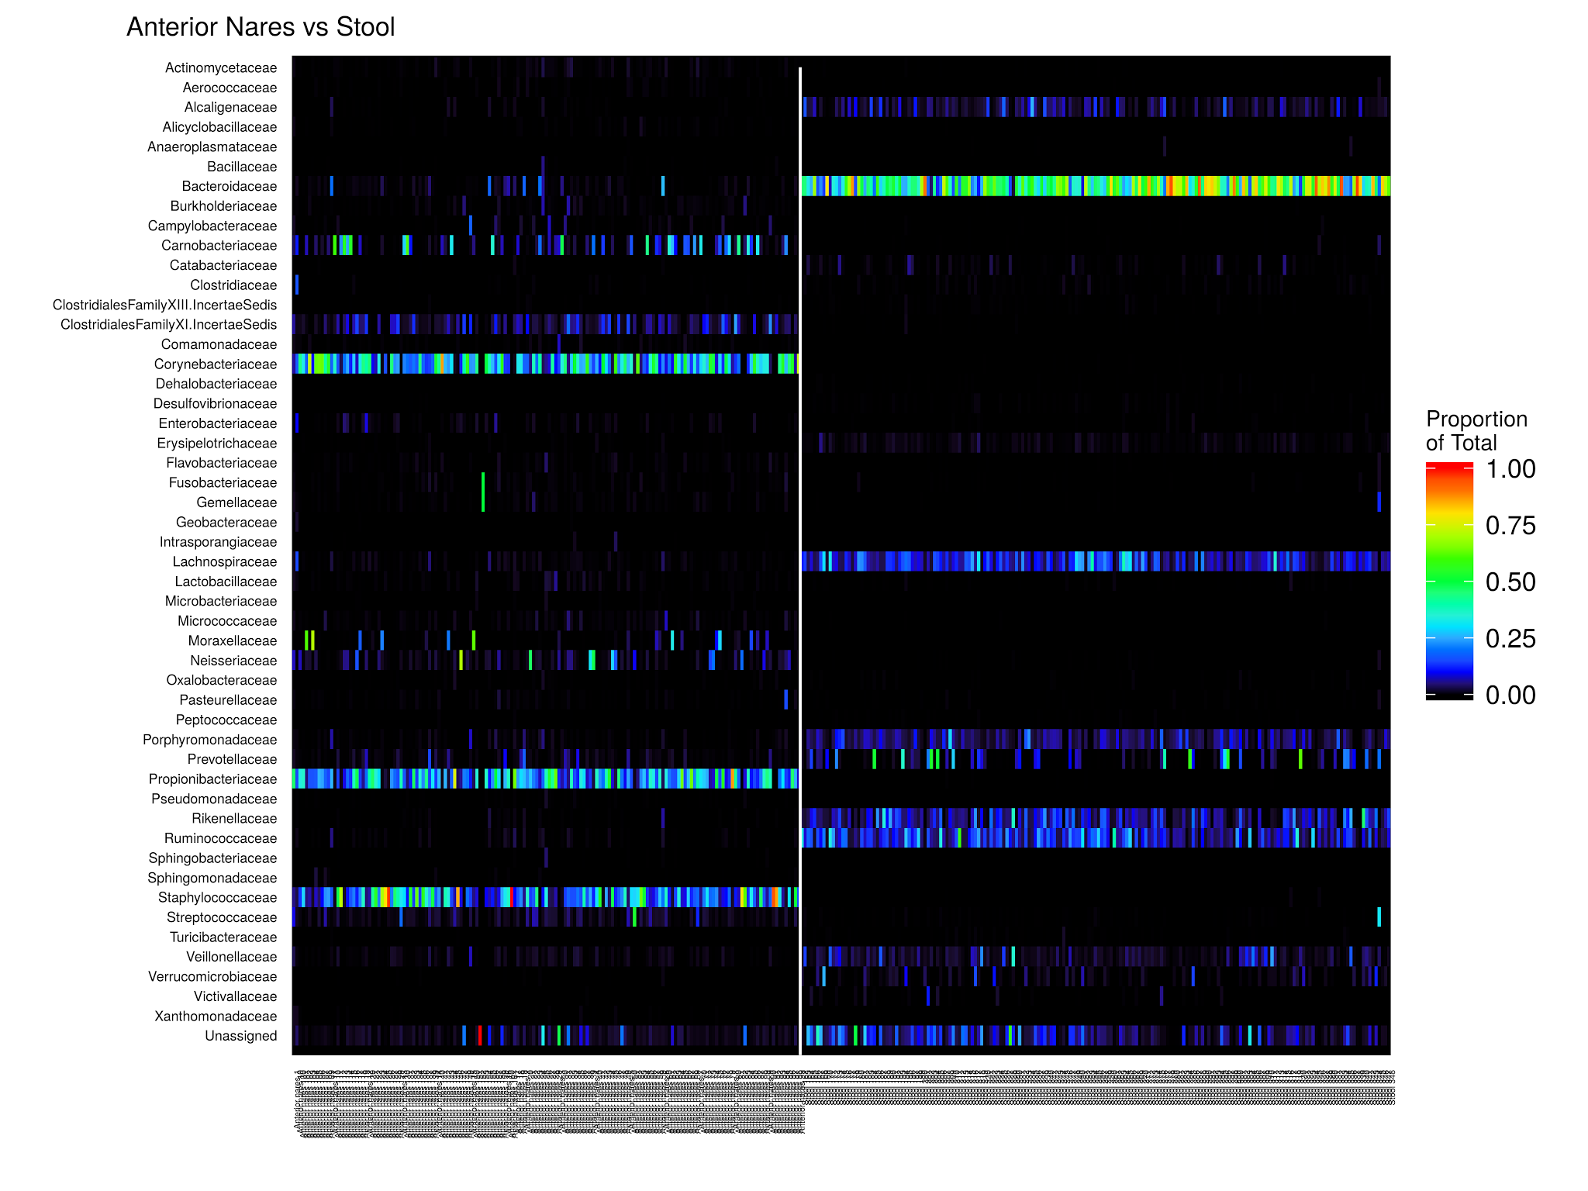

Slide 9
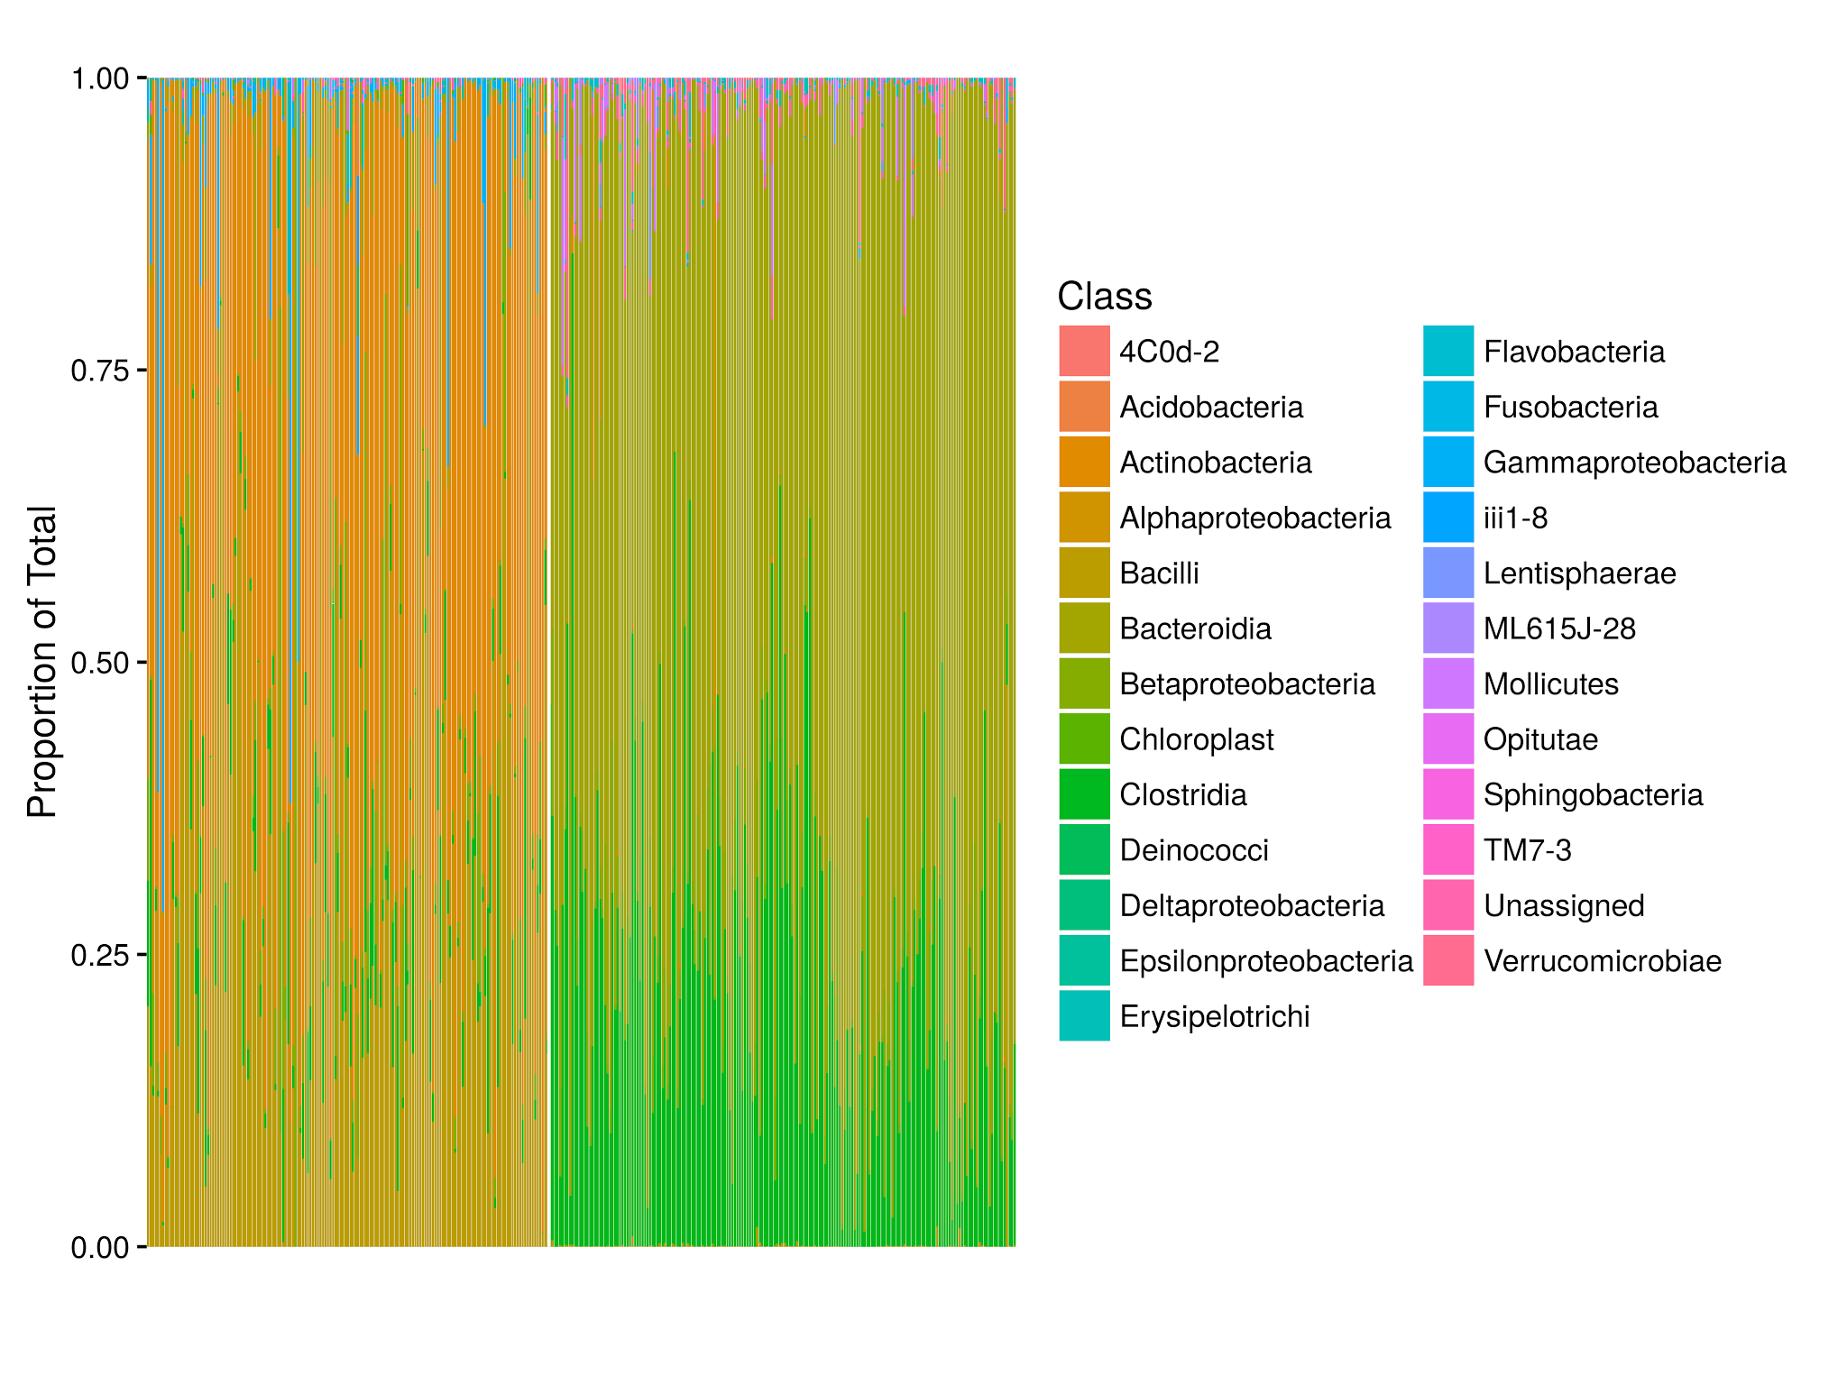

Slide 10
Descriptive: Heatmaps & Barplots
Visualization of OTU table:
typically present counts as a proportion of sample total
choice of sample order can highlight group differences
Limitations:
cannot depict full list of OTUs
space dictates taxonomic level presented

Slide 11
Single-Taxon Hypotheses
You suspect Bacteroides has a relationship with outcome of interest...
Bacteroides (genus)?
Bacteroidaceae (family)?
Bacteroidales (order)?
Bacteroidetes (class)?
Hypotheses focusing on specific taxa often fail to account for possibility of selection bias from culture.

Slide 12
OTU | assignment | phylum | class | order | family | genus
OTU_97.1 | Root;p__Firmicutes;c__Bacilli;o__Lactobacillales;f__Lactobacillaceae;g__Lactobacillus | Firmicutes | Bacilli | Lactobacillales | Lactobacillaceae | Lactobacillus
OTU_97.10 | Root;p__Firmicutes;c__Clostridia;o__Clostridiales;f__Veillonellaceae;g__Veillonella | Firmicutes | Clostridia | Clostridiales | Veillonellaceae | Veillonella
OTU_97.100 | Root;p__Firmicutes;c__Clostridia;o__Clostridiales;f__Veillonellaceae | Firmicutes | Clostridia | Clostridiales | Veillonellaceae | NA
OTU_97.1000 | Root;p__Proteobacteria;c__Betaproteobacteria | Proteobacteria | Betaproteobacteria | NA | NA | NA
OTU_97.10000 | Root;p__Actinobacteria;c__Actinobacteria;o__Actinomycetales;f__Propionibacteriaceae;g__Propionibacterium | Actinobacteria | Actinobacteria | Actinomycetales | Propionibacteriaceae | Propionibacterium
OTU_97.10001 | Root;p__Firmicutes;c__Bacilli;o__Lactobacillales;f__Lactobacillaceae;g__Lactobacillus | Firmicutes | Bacilli | Lactobacillales | Lactobacillaceae | Lactobacillus
OTU_97.10002 | Root;p__Firmicutes;c__Clostridia;o__Clostridiales;f__Lachnospiraceae | Firmicutes | Clostridia | Clostridiales | Lachnospiraceae | NA
OTU_97.10003 | Root;p__Actinobacteria;c__Actinobacteria;o__Actinomycetales;f__Propionibacteriaceae;g__Propionibacterium | Actinobacteria | Actinobacteria | Actinomycetales | Propionibacteriaceae | Propionibacterium
OTU_97.10004 | Root;p__Actinobacteria;c__Actinobacteria;o__Actinomycetales;f__Corynebacteriaceae;g__Corynebacterium | Actinobacteria | Actinobacteria | Actinomycetales | Corynebacteriaceae | Corynebacterium
OTU_97.10005 | Root;p__Bacteroidetes;c__Bacteroidia;o__Bacteroidales;f__Bacteroidaceae;g__Bacteroides | Bacteroidetes | Bacteroidia | Bacteroidales | Bacteroidaceae | Bacteroides

Slide 13
Outline
The problem: too much data.
Reducing dimensions:
richness, evenness, and diversity
ecological distances (UniFrac)
PCA & PCoA
PERMANOVA (adonis)
Cluster analysis:
supervised vs unsupervised learning
Dirichlet multinomial mixture modeling

Slide 14
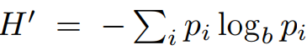
Dimension Reduction: Alpha Diversity
Summarize each sample’s community in a single measure:
richness: number of community members
evenness: the distribution of member counts
Many alpha diversity metrics (weight richness/evenness):
species number, Chao1 (singletons & doubletons)
Shannon diversity:
(note: may measure similarity or dissimilarity)

Slide 15
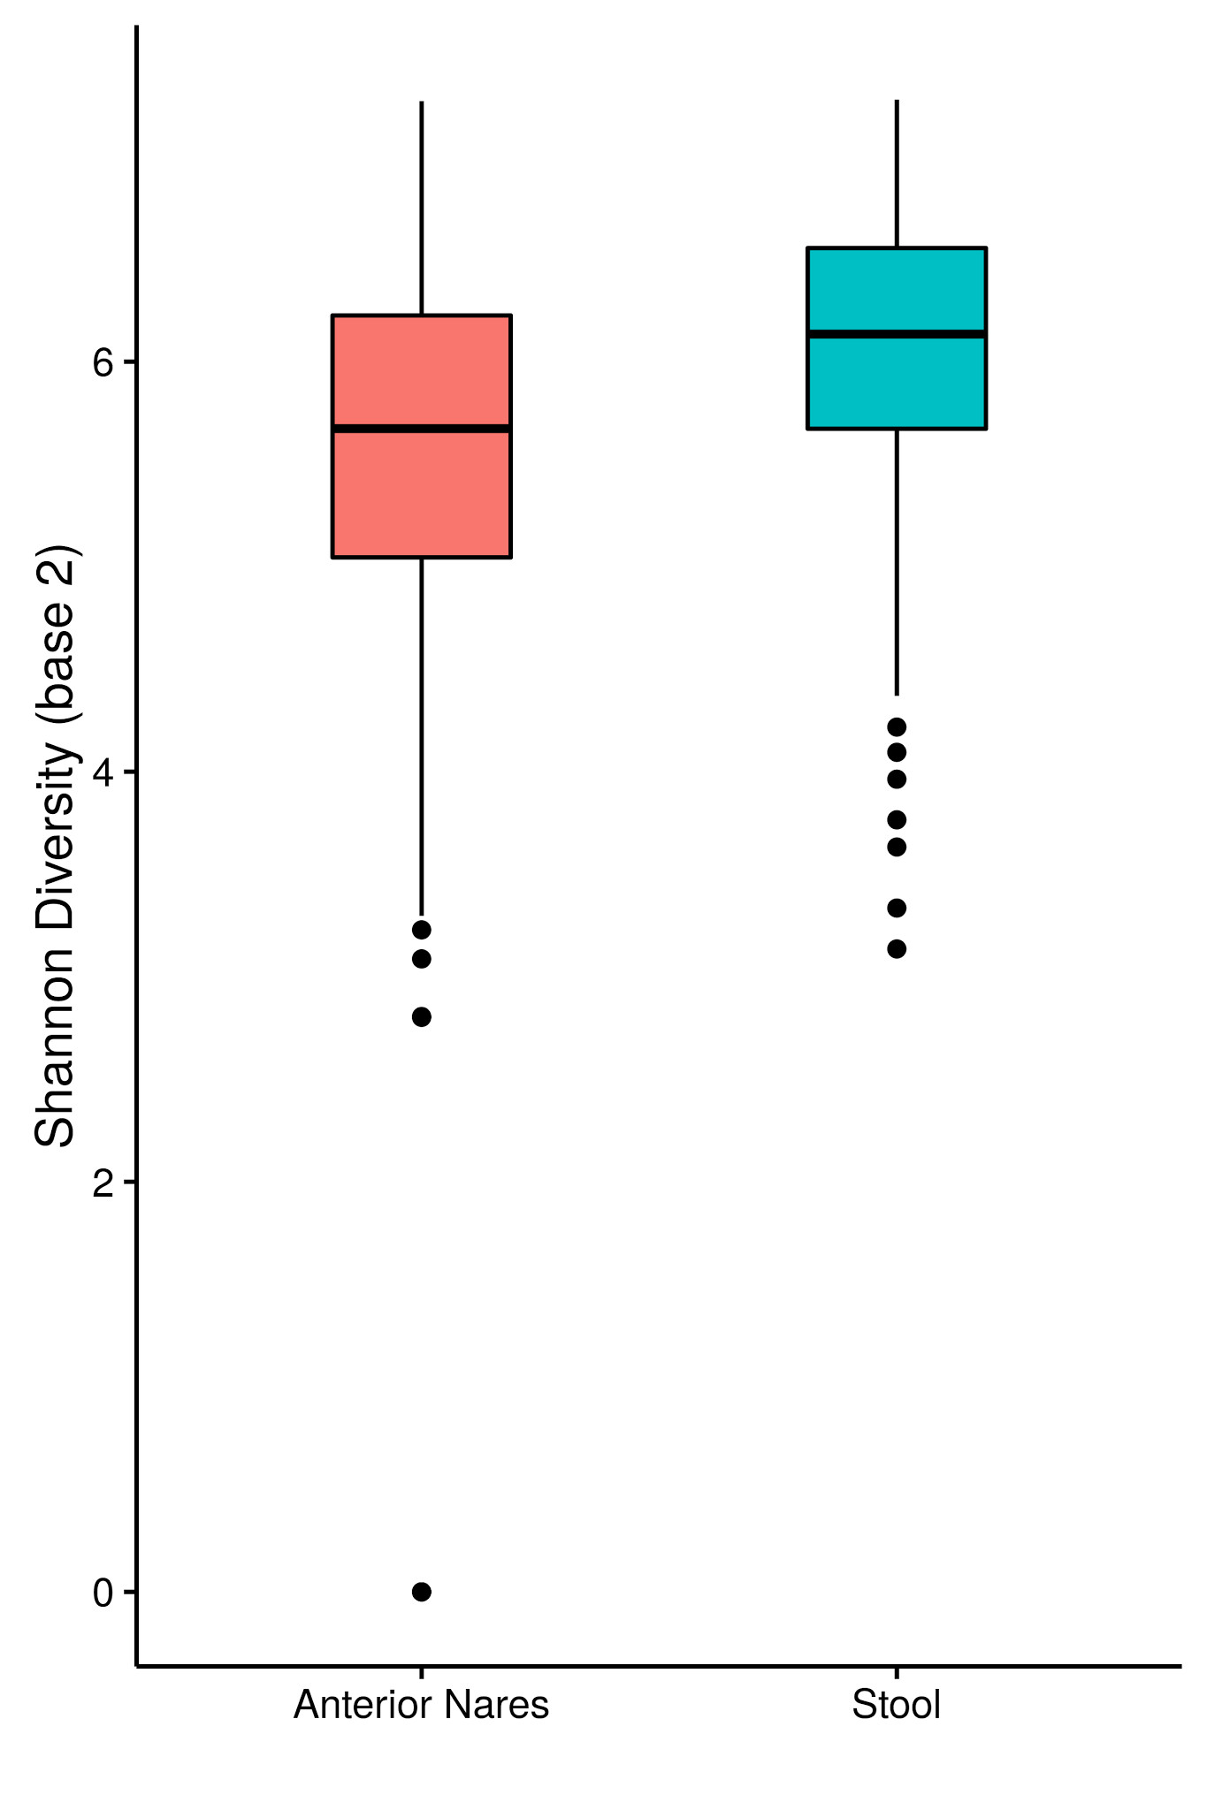

Slide 16
Outline
The problem: too much data.
Reducing dimensions:
richness, evenness, and diversity
ecological distances (UniFrac)
PCA & PCoA
PERMANOVA (adonis)
Cluster analysis:
supervised vs unsupervised learning
Dirichlet multinomial mixture modeling

Slide 17
Dimension Reduction: Beta Diversity
Summarize each sample’s relationship to other samples:
pairwise distances
OTU table → square matrix
Many beta diversity metrics:
just counts versus counts + phylogeny
weighted versus unweighted
(Euclidean versus non-Euclidean)

Slide 18
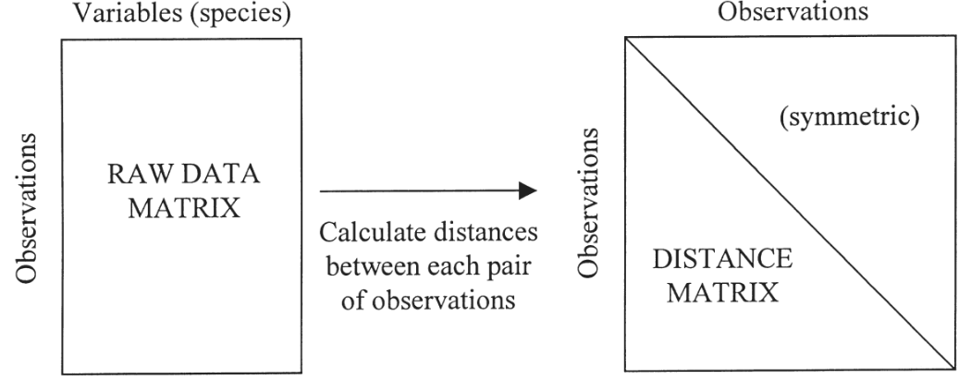
Anderson MJ et al. Austral Ecol 2001;26(1):32-46.

Slide 19
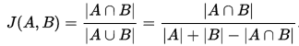
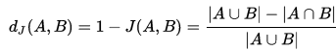
Dimension Reduction: Beta Diversity
Just counts versus counts + phylogeny:
Jaccard:
UniFrac: fraction of unique branch length in tree
Weighted versus unweighted:
weighted: counts matter
unweighted: binary (presence-absence)

Slide 20
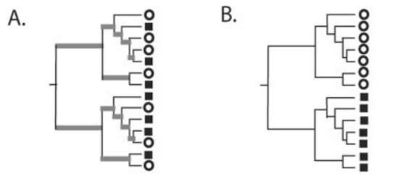
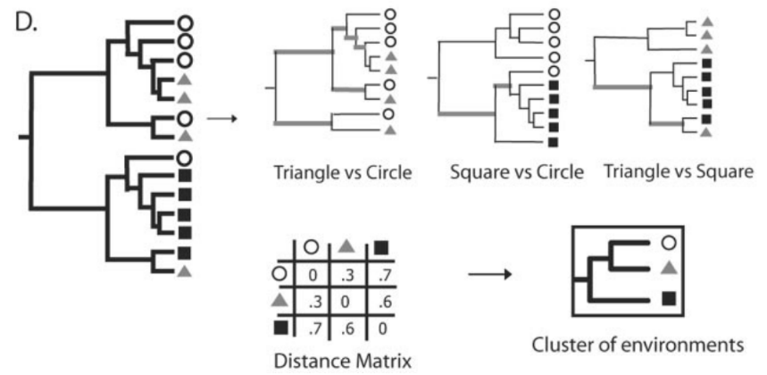

Slide 21
Beta Diversity: How to Choose?
Why use Jaccard? UniFrac?
Why use weighted? Unweighted?

Slide 22
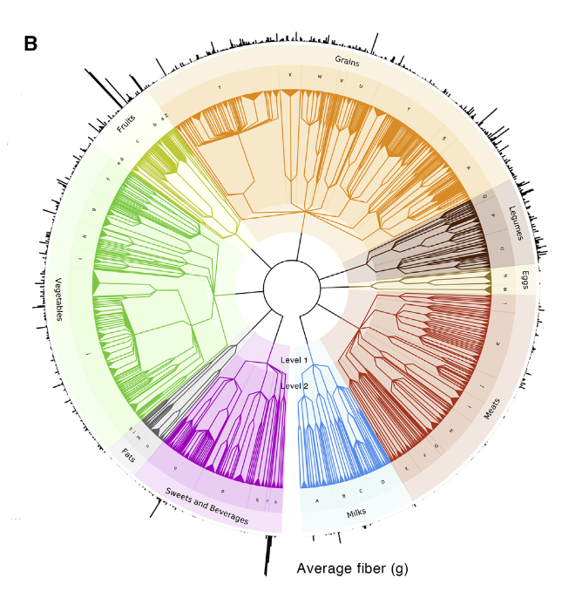
Thinking Like a Tree
Johnson AJ et al. Cell Host Microbe 2019.

Slide 23
Outline
The problem: too much data.
Reducing dimensions:
richness, evenness, and diversity
ecological distances (UniFrac)
PCA & PCoA
PERMANOVA (adonis)
Cluster analysis:
supervised vs unsupervised learning
Dirichlet multinomial mixture modeling

Slide 24
Original Descriptors: PCA
PCA: principal component analysis
rigid rotation for successive directions of maximum variance
lots of restrictions (Euclidean)
but allows projection of original descriptors in PCA space

Slide 25
Pairwise Distances: PCoA
PCoA: principal coordinate analysis
any metric distance, even if non-Euclidean
like PCA, eigenvalue decomposition (maximum variance) but mediated by distance function (no original descriptors)
unlike PCA, does not allow projection of original descriptors in reduced-dimension space

Slide 26
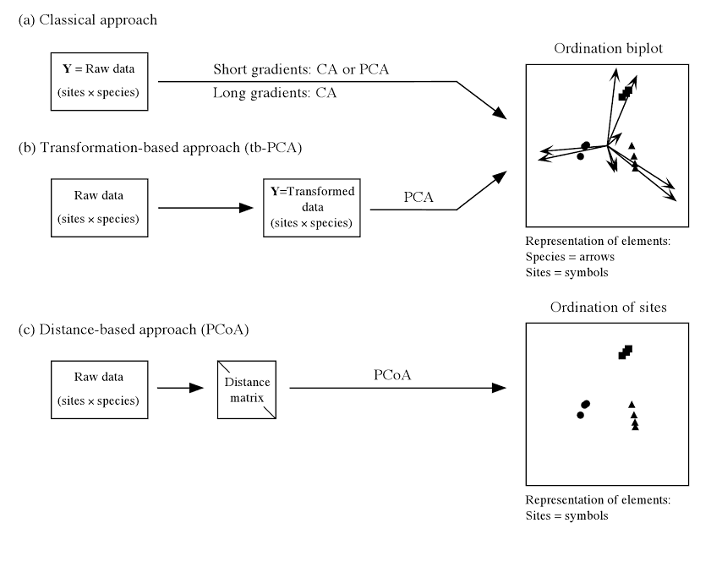

Slide 27
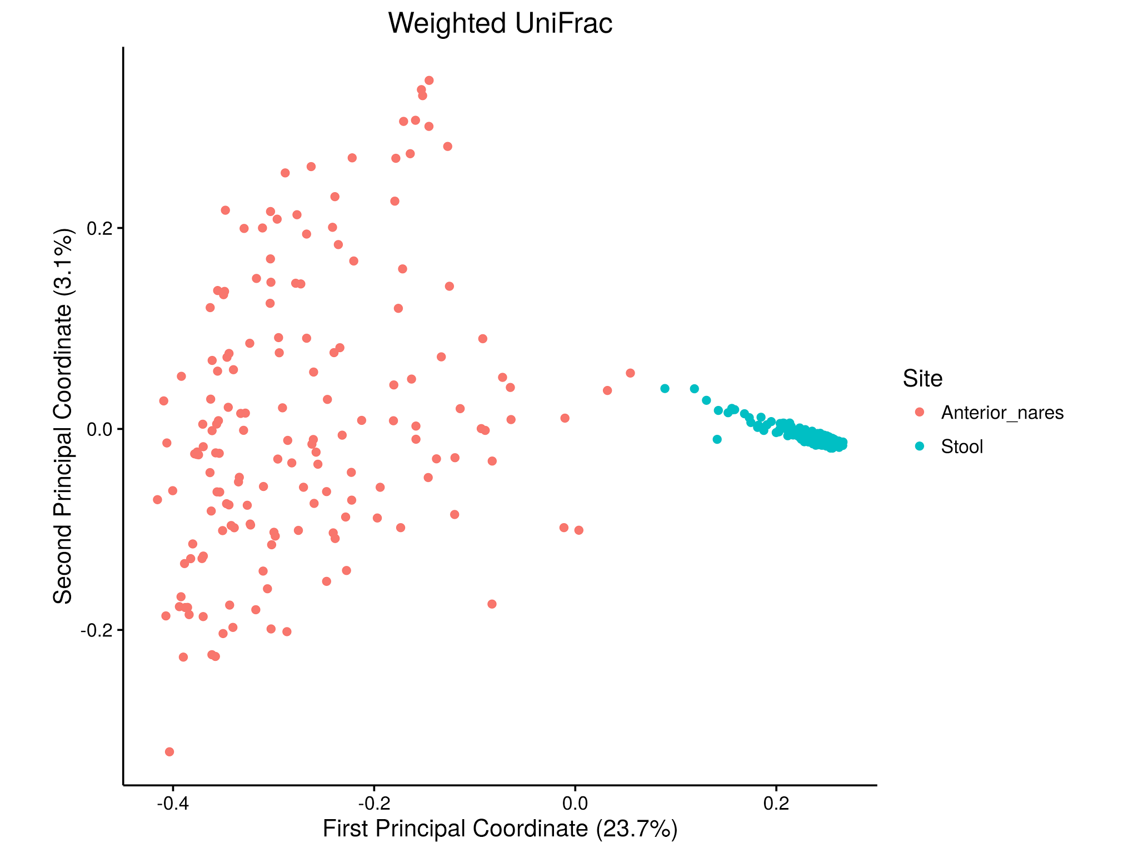

Slide 28
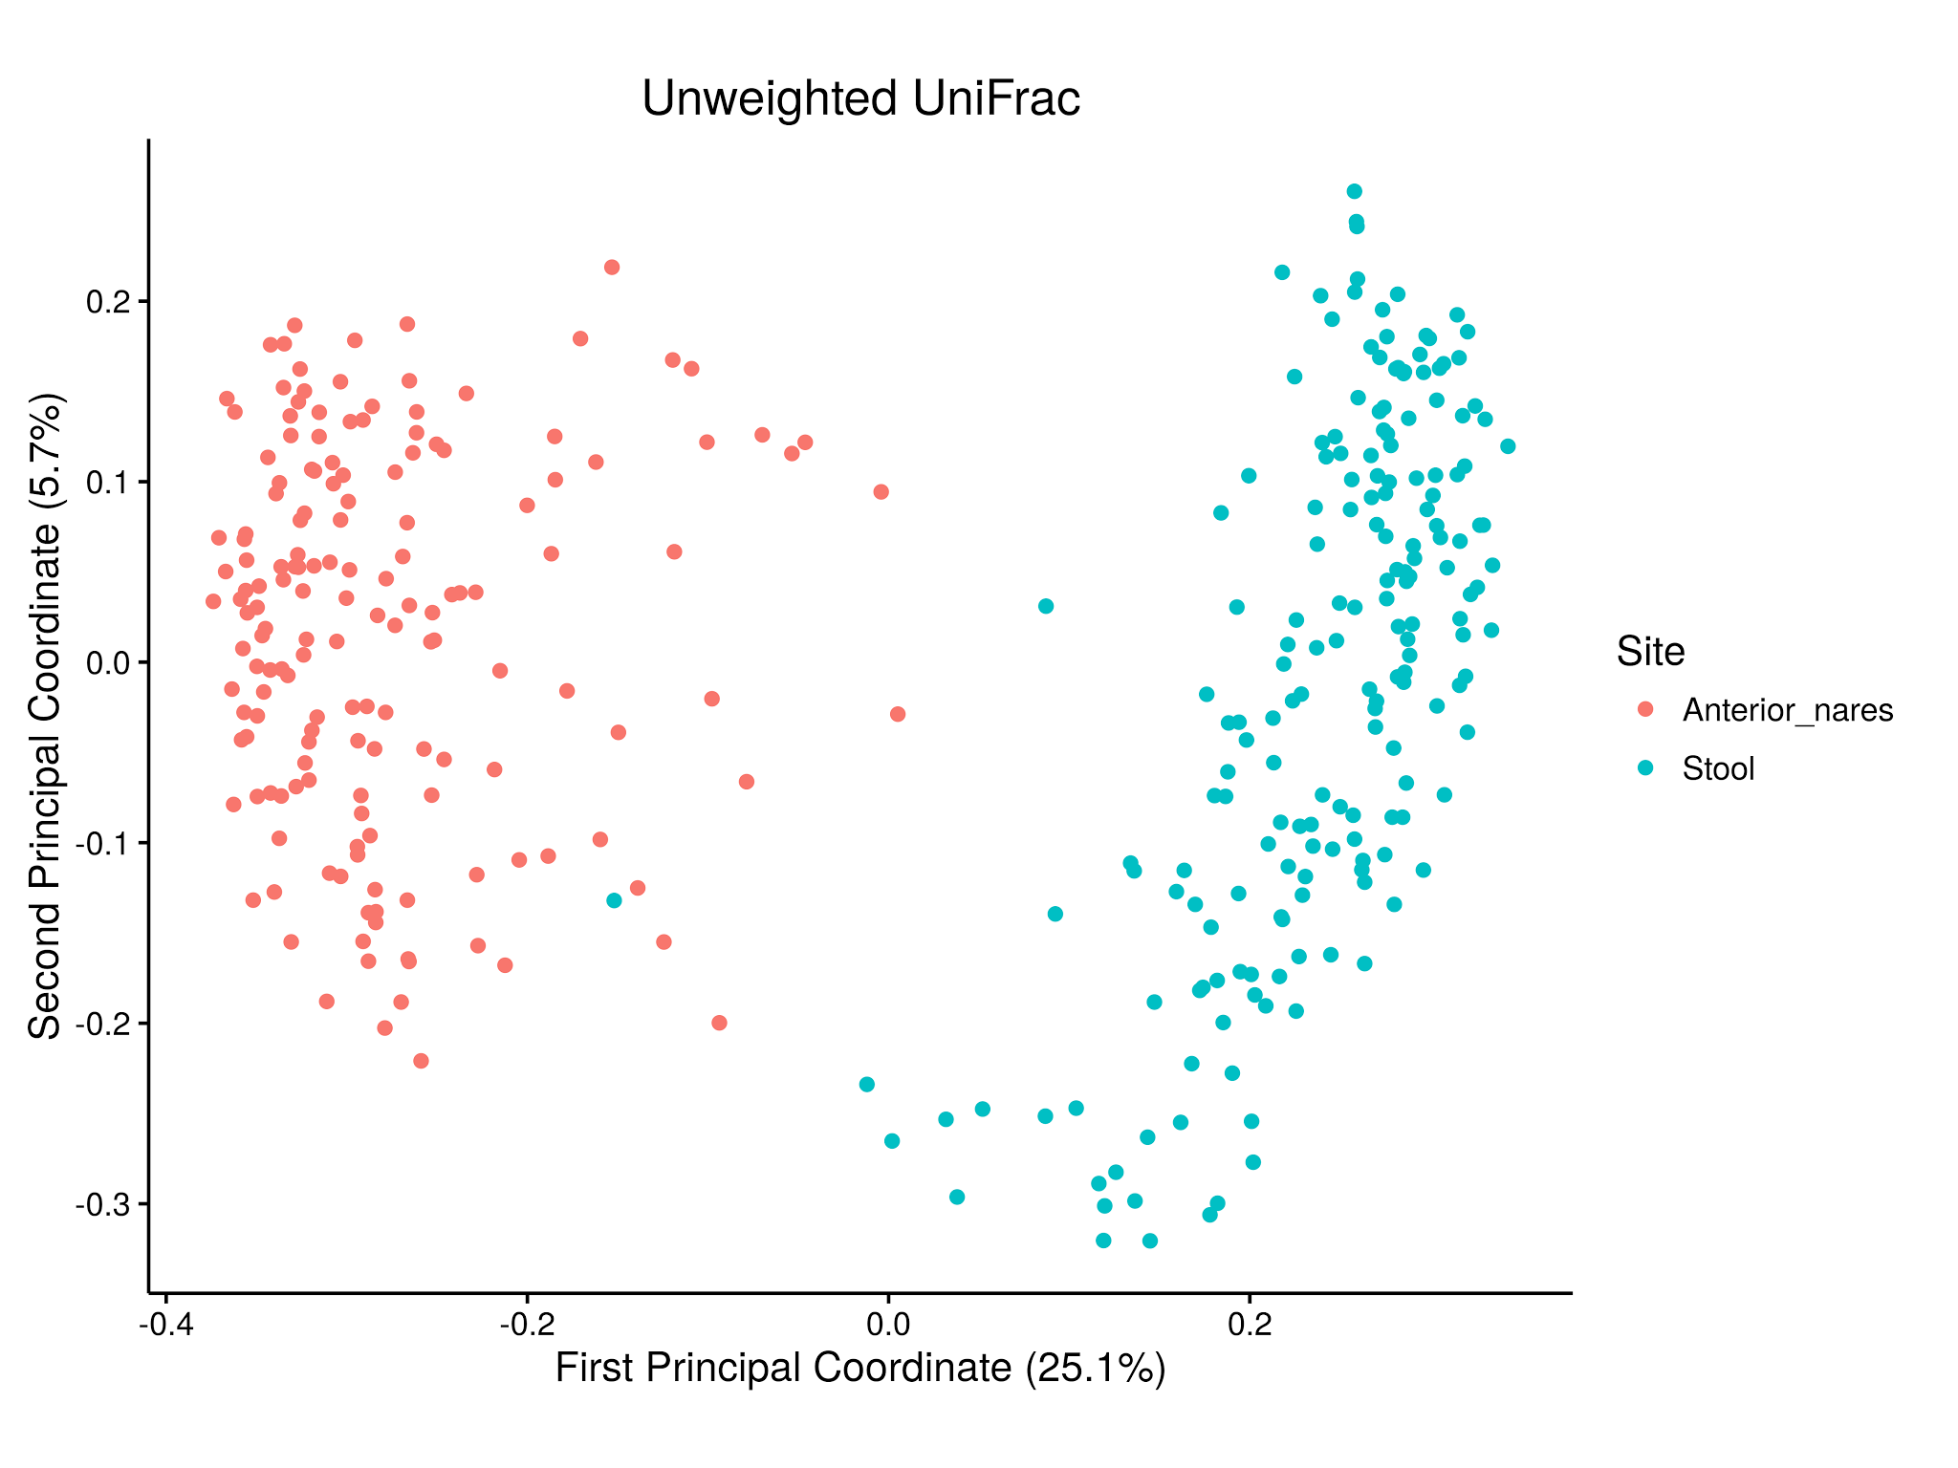

Slide 29
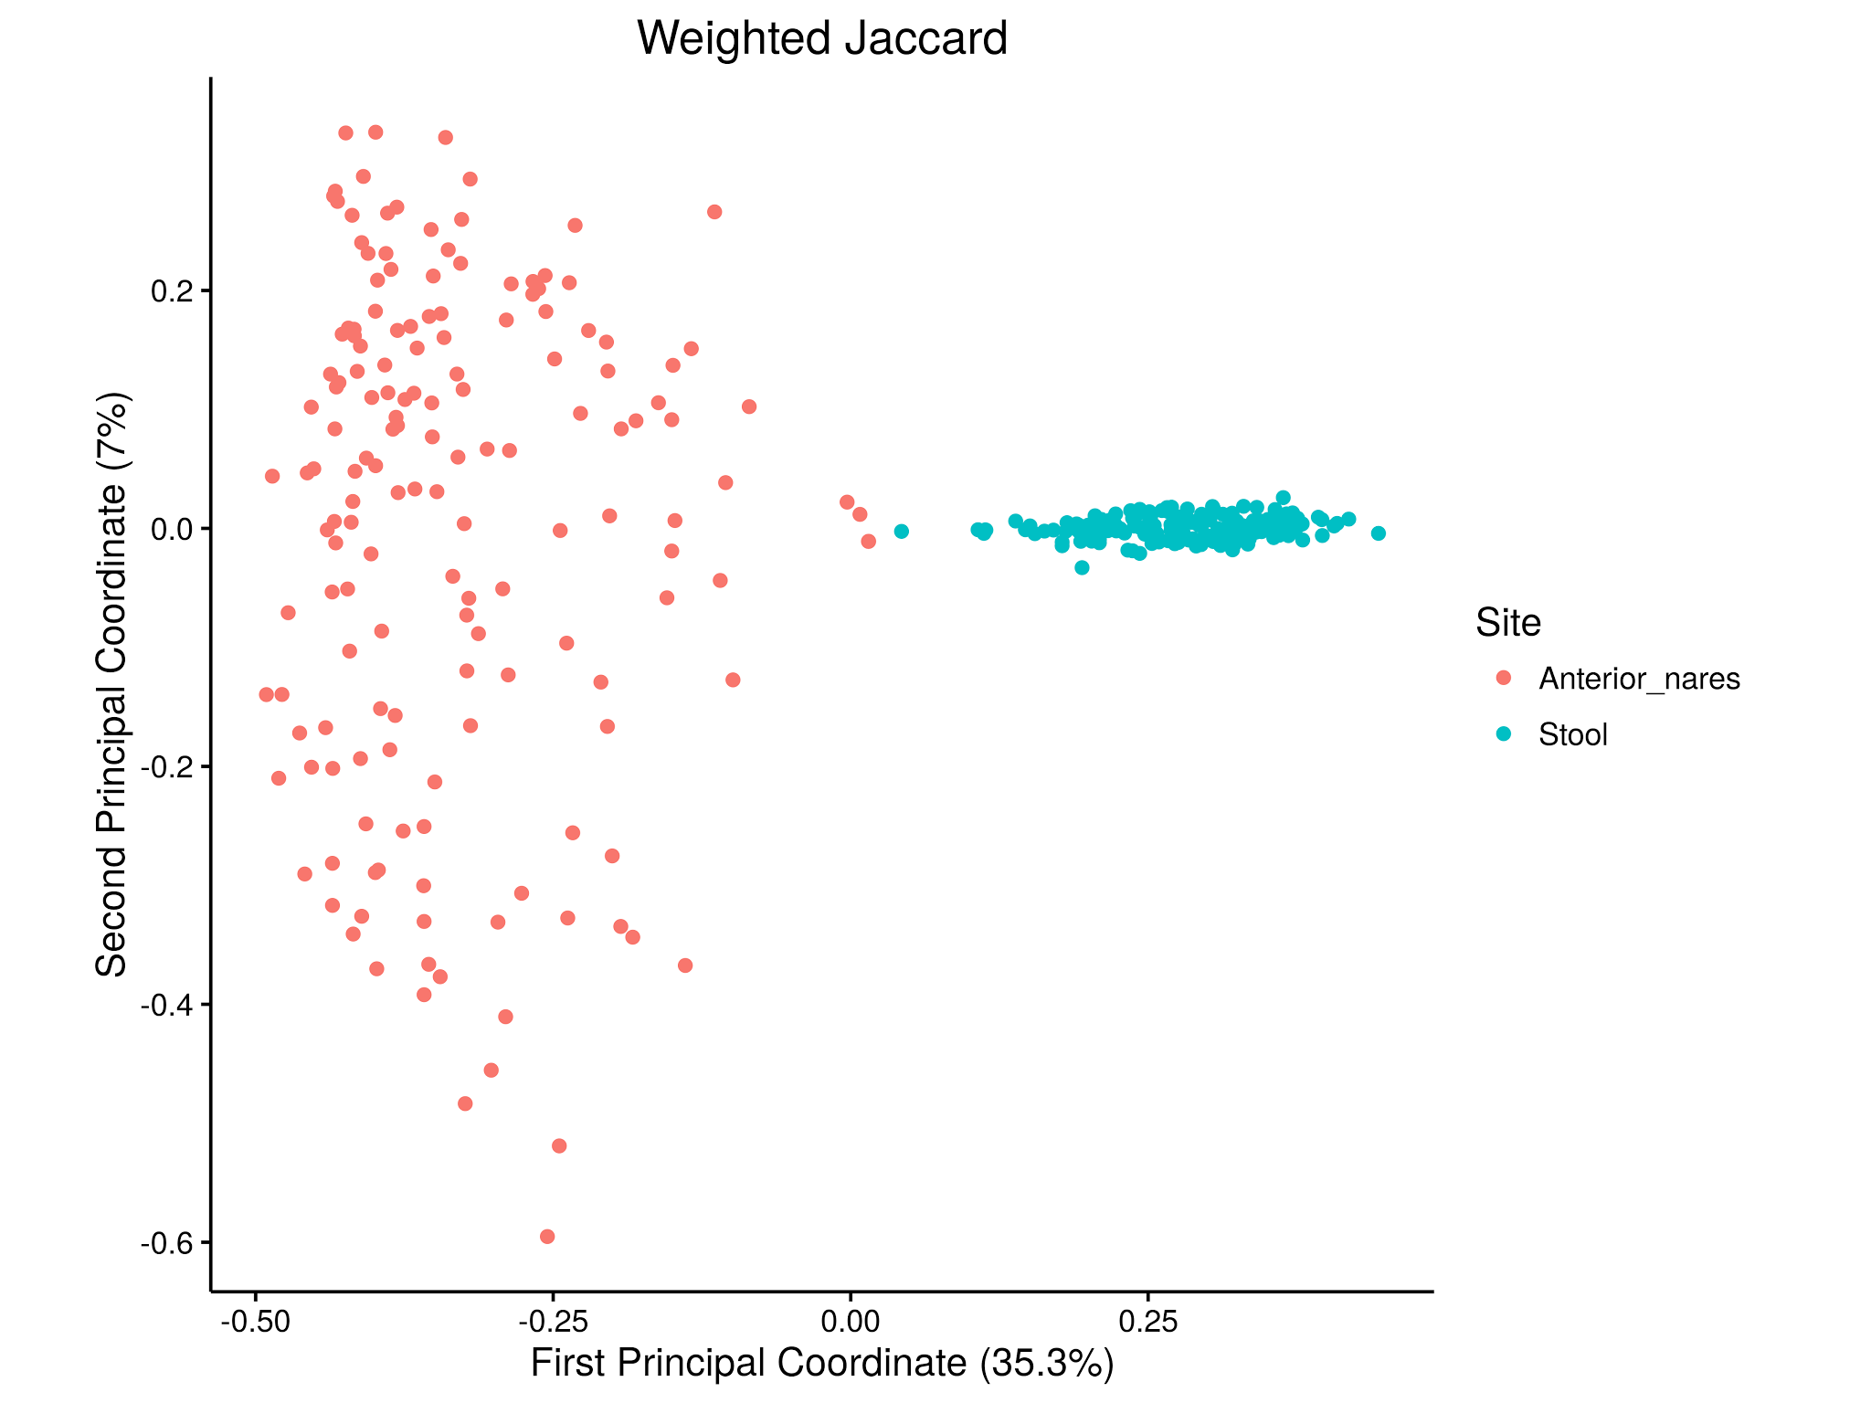

Slide 30
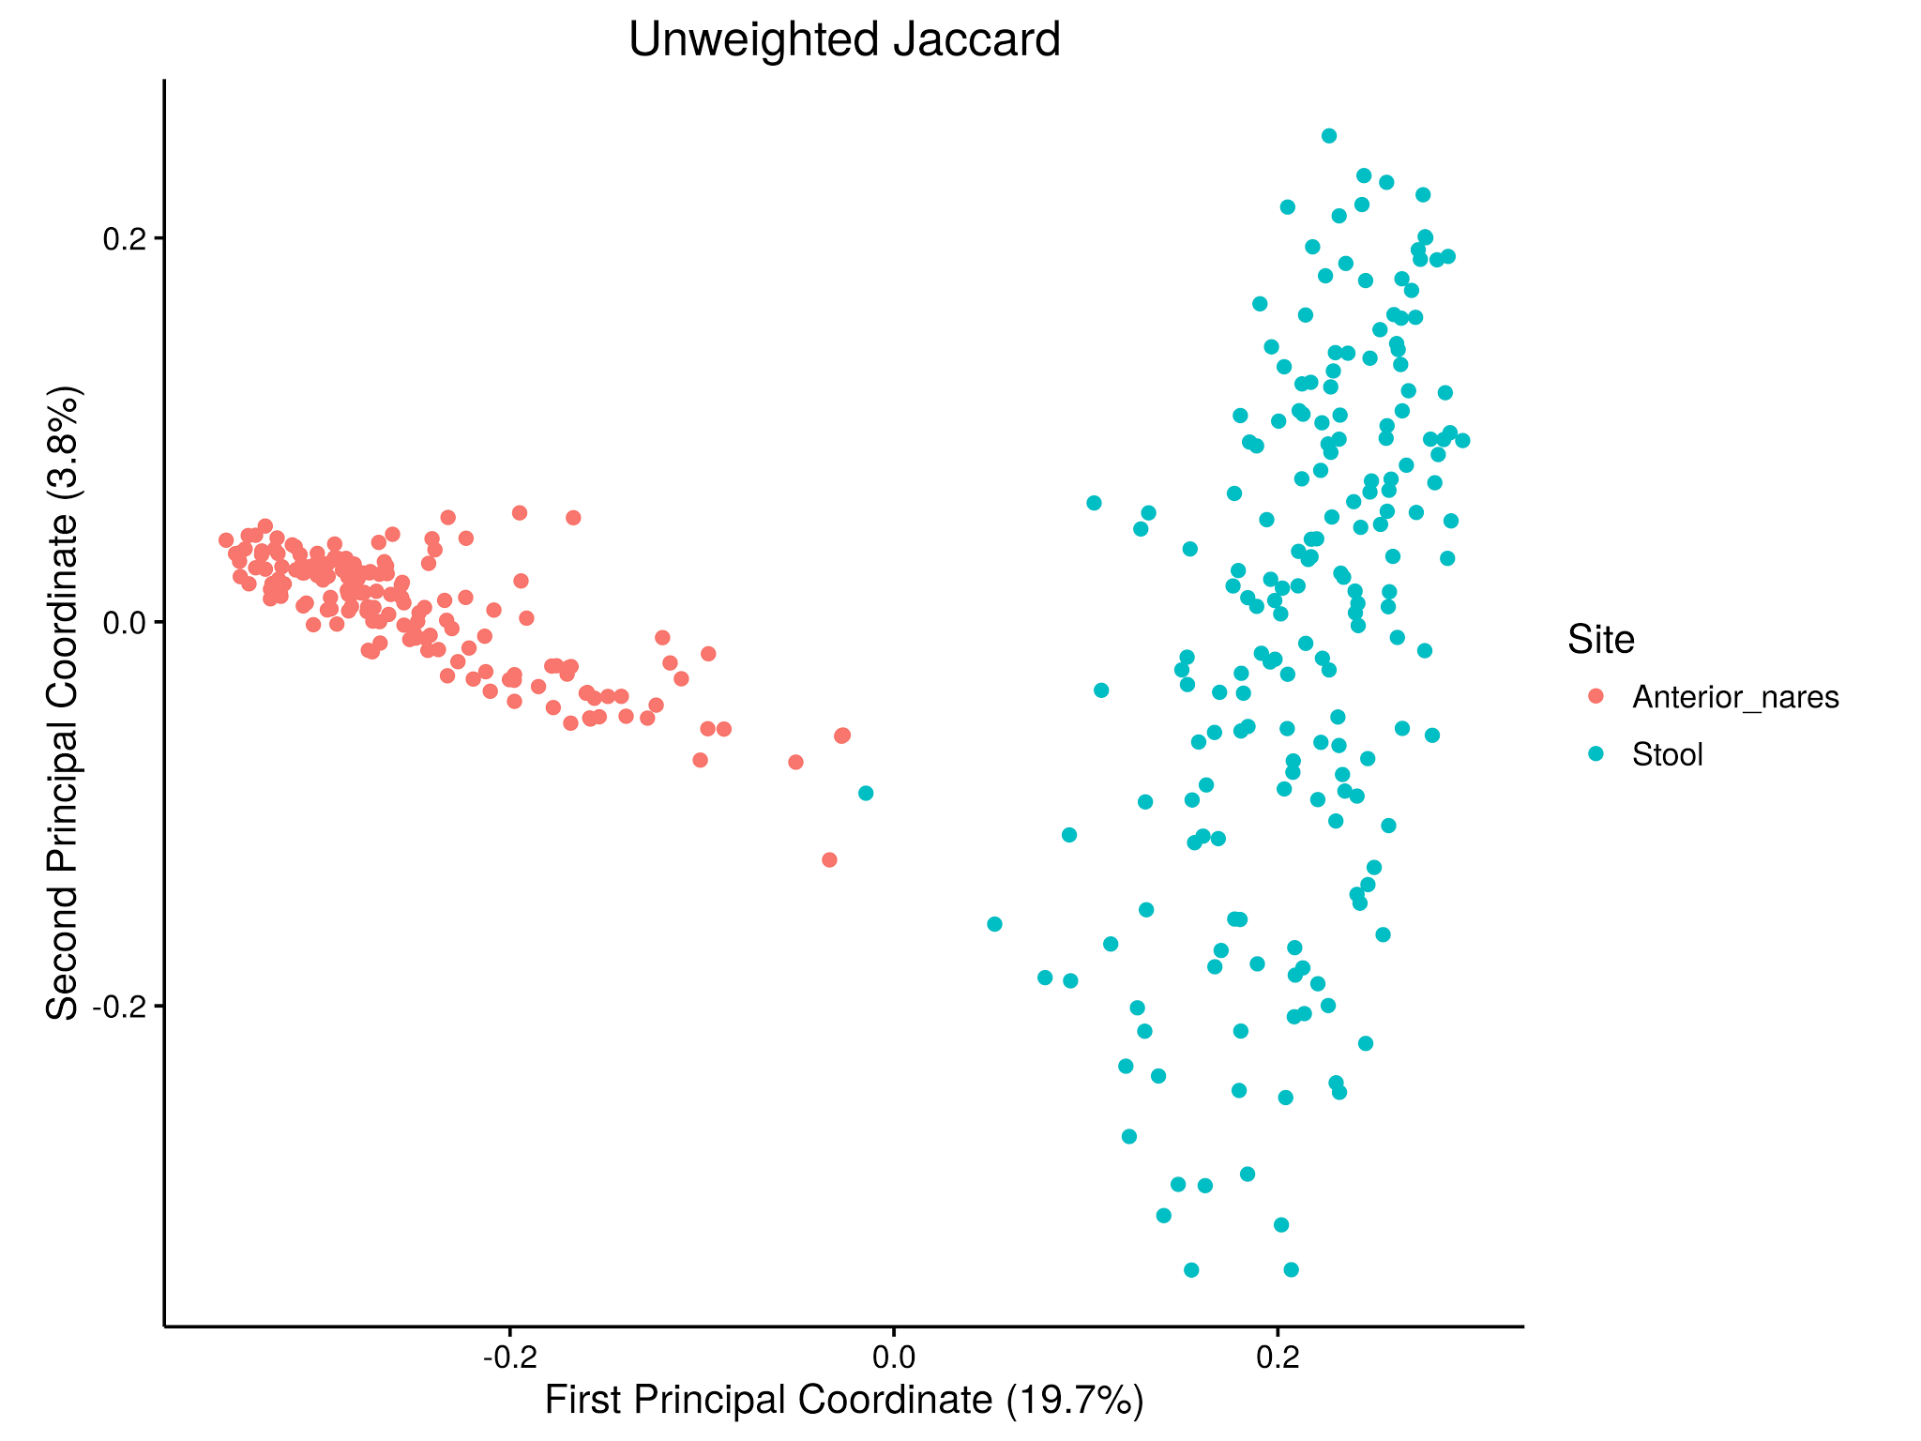

Slide 31


Slide 32
Outline
The problem: too much data.
Reducing dimensions:
richness, evenness, and diversity
ecological distances (UniFrac)
PCA & PCoA
PERMANOVA (adonis)
Cluster analysis:
supervised vs unsupervised learning
Dirichlet multinomial mixture modeling

Slide 33
Pairwise Distances: PERMANOVA
Pairwise distance matrix can be partitioned by group assignment and ANOVA-like analysis can be applied to detect difference between groups.
PERMANOVA: permutational ANOVA (aka, adonis)
pseudo F-ratio: conceptually similar but not F-distributed
testing by label permutation
quantification of effect size by R-squared or omega-squared (the latter a less biased estimator of true effect)

Slide 34
Anderson MJ et al. Austral Ecol 2001;26(1):32-46.

Slide 35
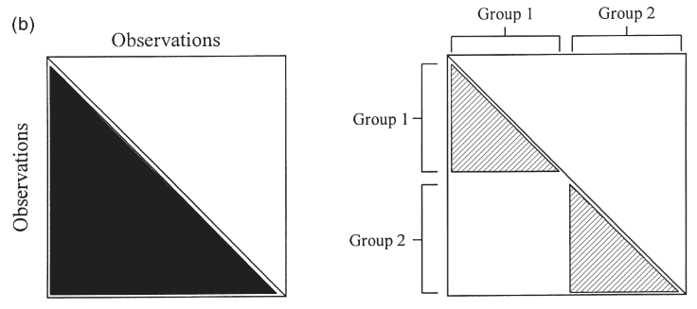
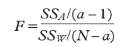
Anderson MJ et al. Austral Ecol 2001;26(1):32-46.

Slide 36
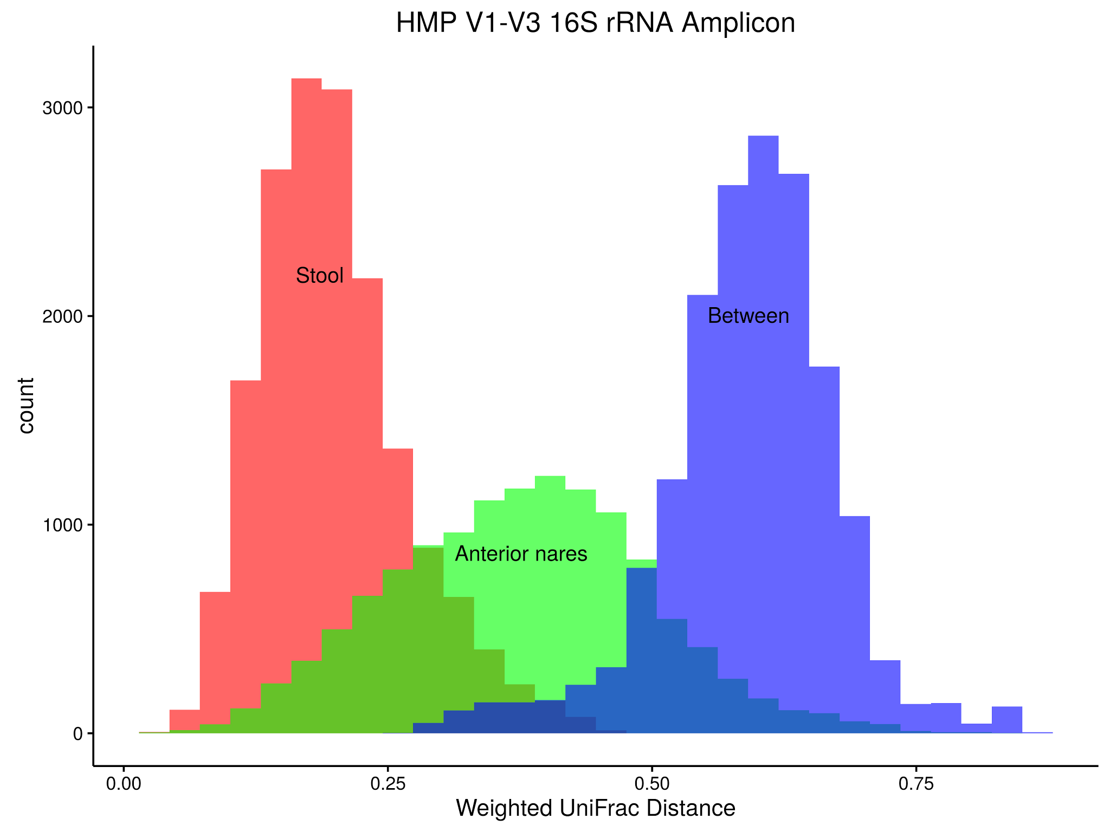

Slide 37
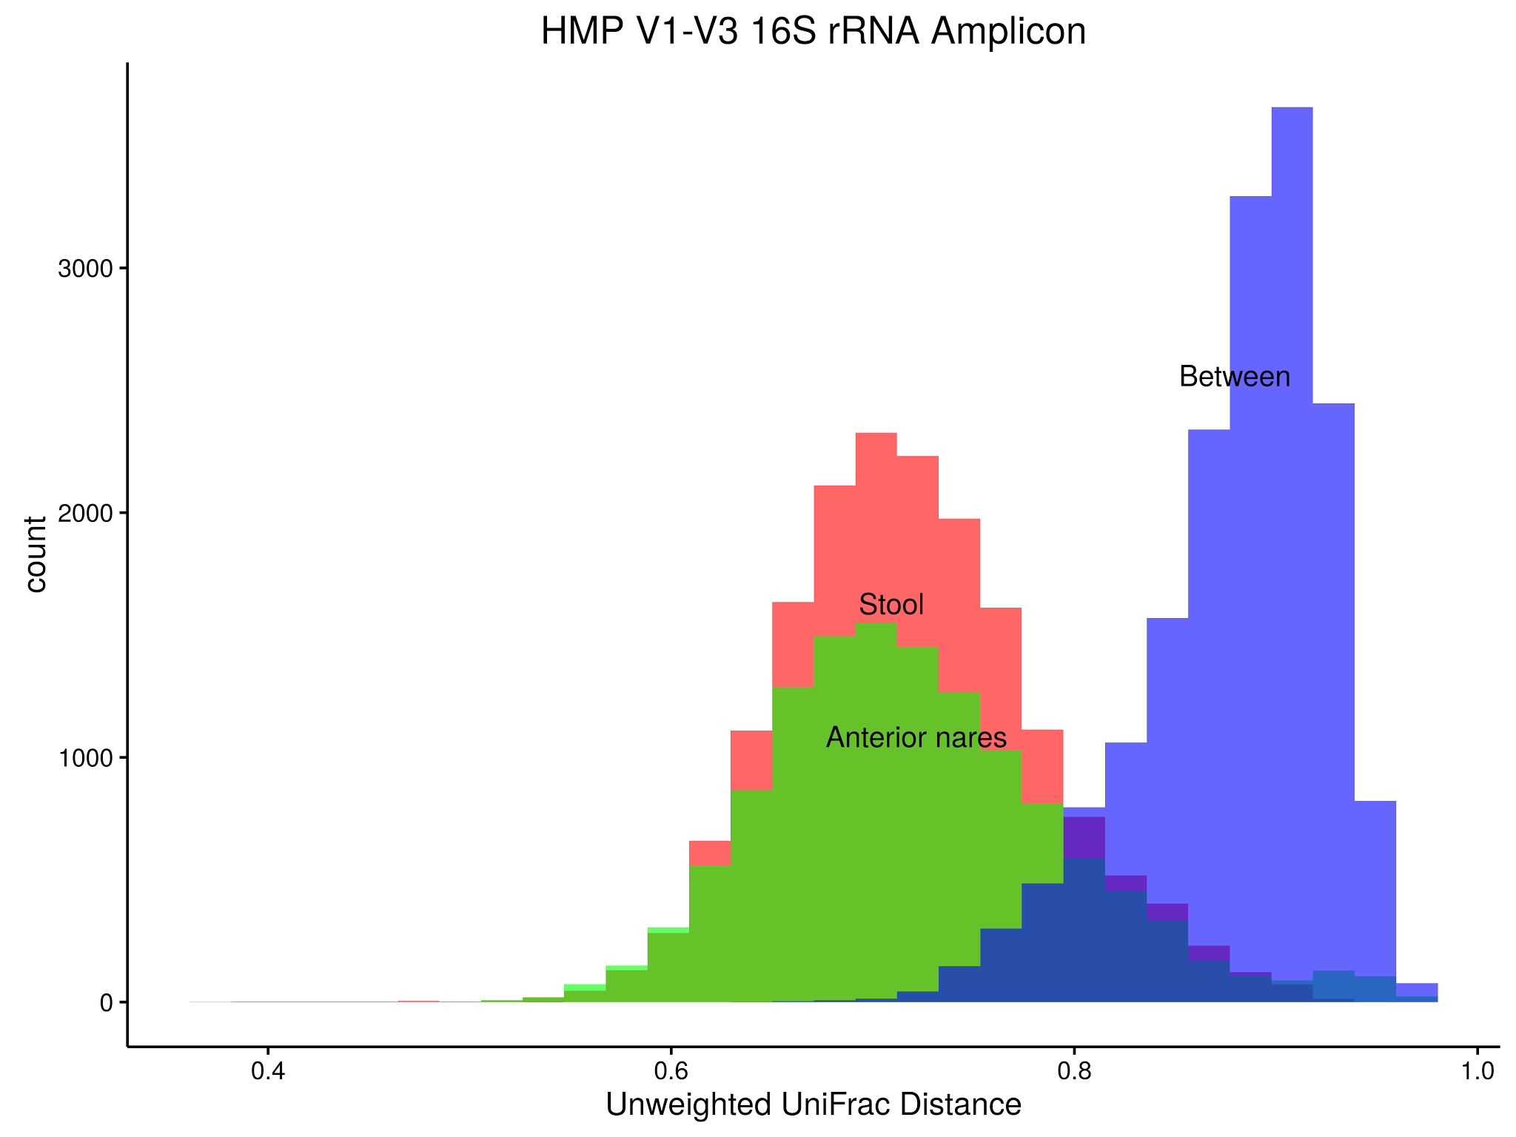

Slide 38
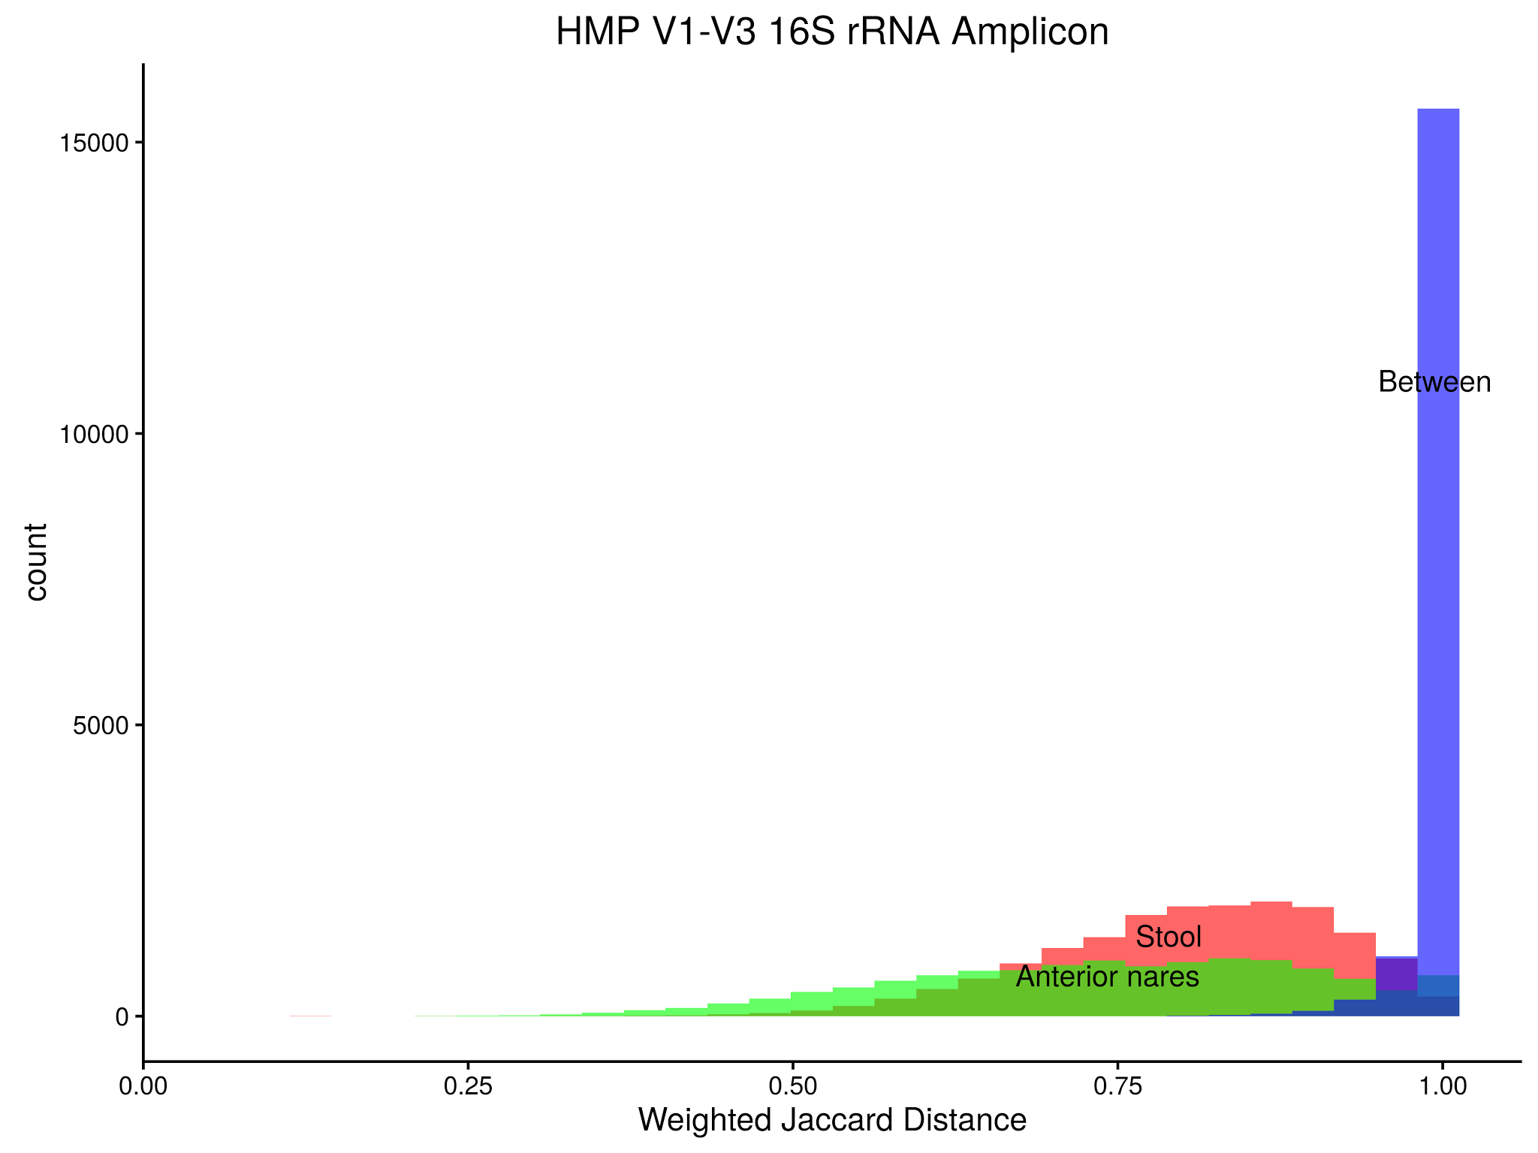

Slide 39
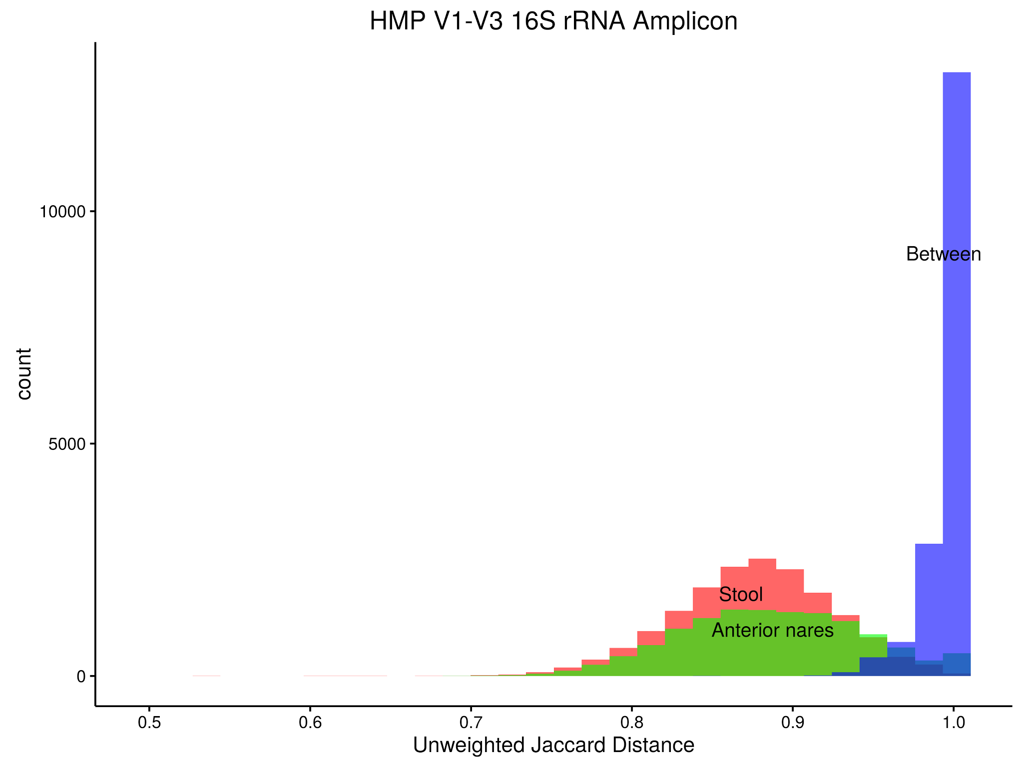

Slide 40
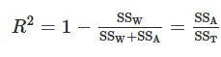
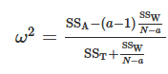
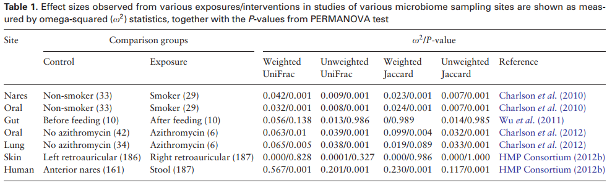
Kelly BJ et al. Bioinformatics 2015;31(15):2461-8.

Slide 41
Kelly BJ et al. Bioinformatics 2015;31(15):2461-8.

Slide 42
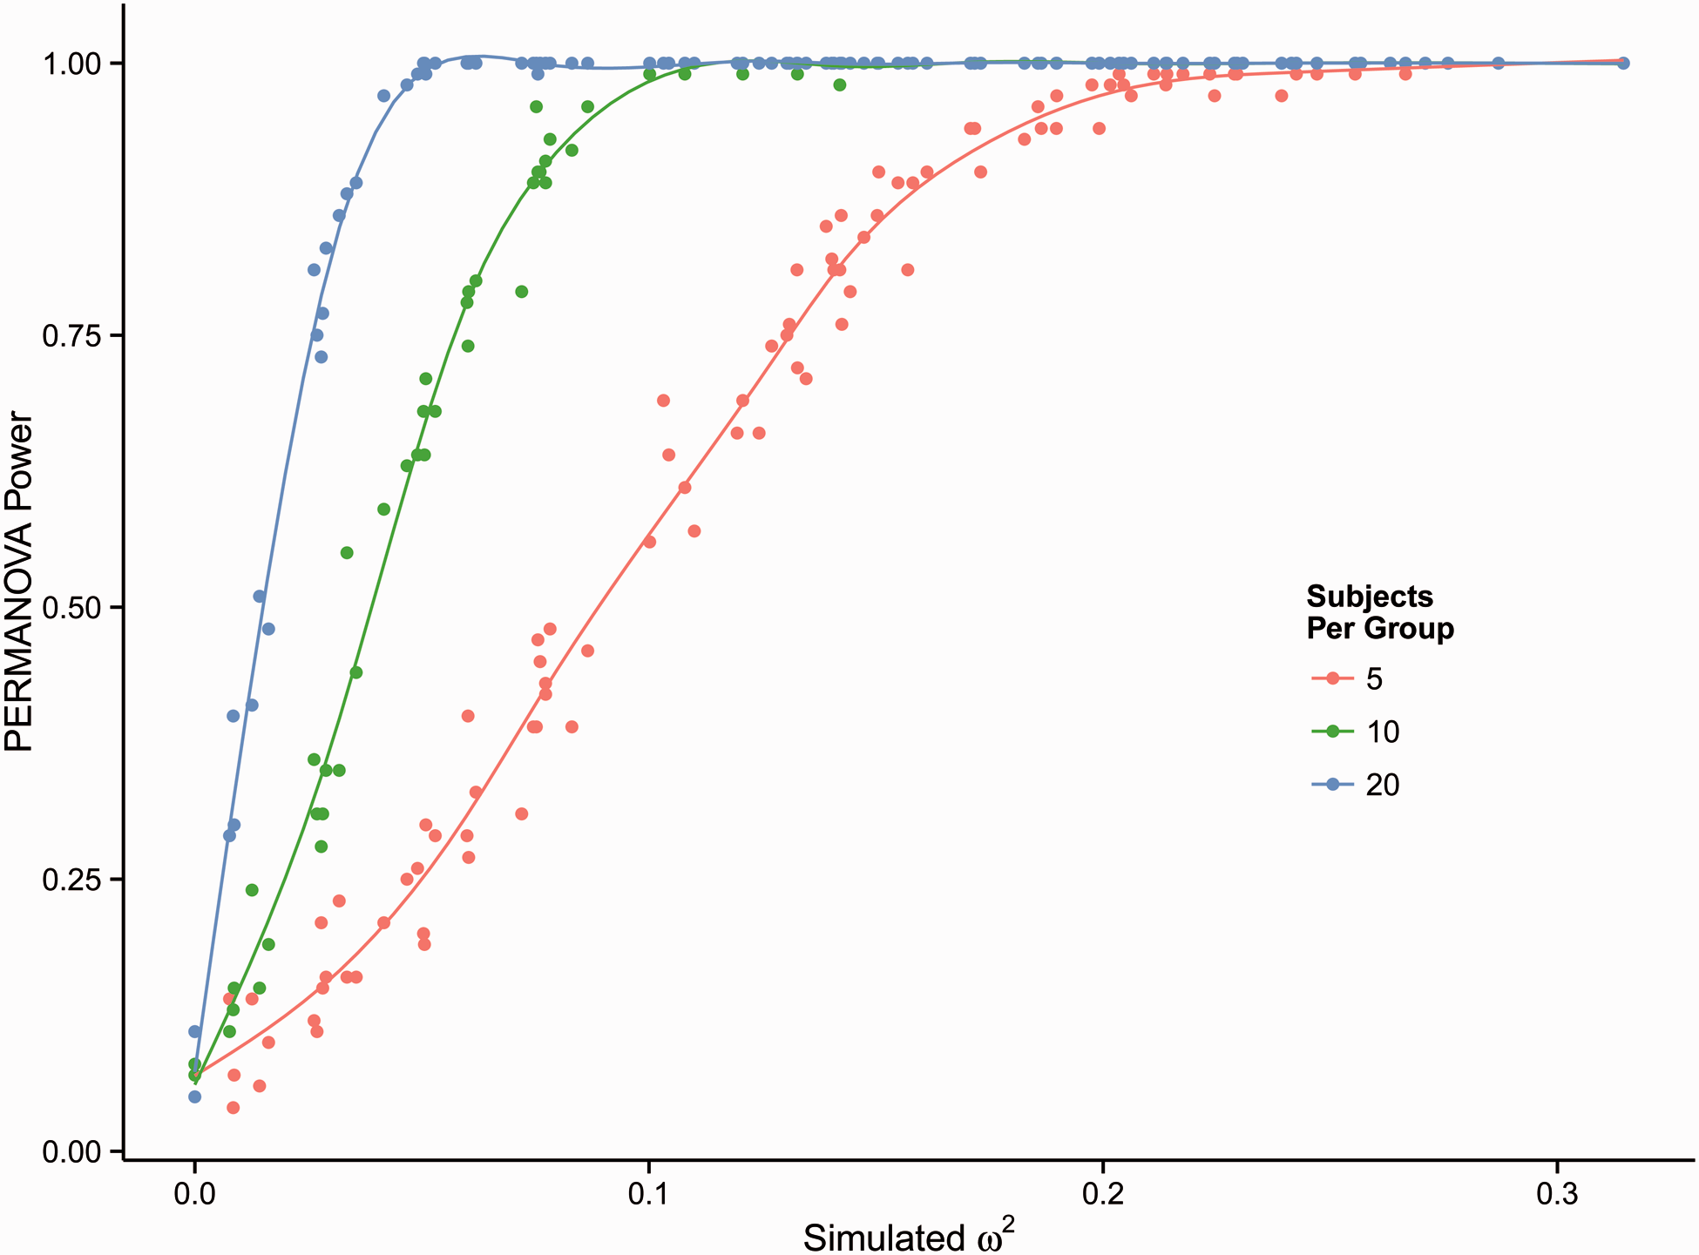
Kelly BJ et al. Bioinformatics 2015;31(15):2461-8.

Slide 43
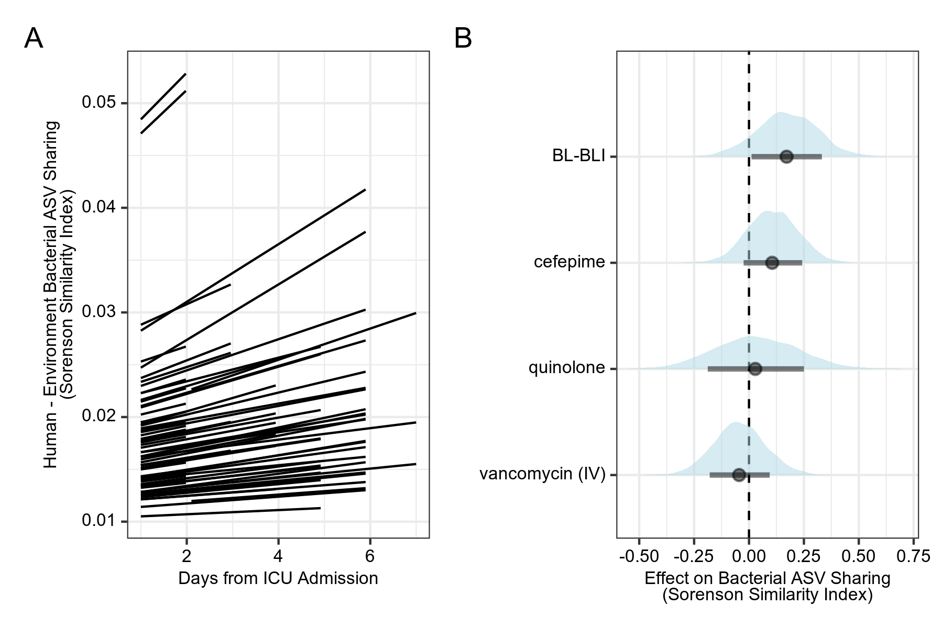
Other Approaches to Modeling Distance

Slide 44
Outline
The problem: too much data.
Reducing dimensions:
richness, evenness, and diversity
ecological distances (UniFrac)
PCA & PCoA
PERMANOVA (adonis)
Cluster analysis:
supervised vs unsupervised learning
Dirichlet multinomial mixture modeling

Slide 45
Statistical / Machine Learning
Supervised learning:
exposure and outcome
regression, linear discriminant analysis, KNN clustering
test & training data; cross-validation
Unsupervised learning:
understand relationships between observations or variables
can we reduce the dimensions of microbiome data?
Holmes I et al. PLoS One 2012.

Slide 46



Slide 47
Outline
The problem: too much data.
Reducing dimensions:
richness, evenness, and diversity
ecological distances (UniFrac)
PCA & PCoA
PERMANOVA (adonis)
Cluster analysis:
supervised vs unsupervised learning
Dirichlet multinomial mixture modeling

Slide 48
Dimension Reduction: Mixture Models
Dirichlet-multinomial distribution:
compound probability distribution: probability vector drawn from Dirichlet distribution (generalized beta) → observation drawn from multinomial distribution (generalized binomial)
D-M mixture modelling:
each sample ~ multinomial from one Dirichlet vector
# Dirichlet vectors: minimize -log(model evidence, Laplace approx)
Dirichlet probability vectors = “community types”
Holmes I et al. PLoS One 2012.

Slide 49
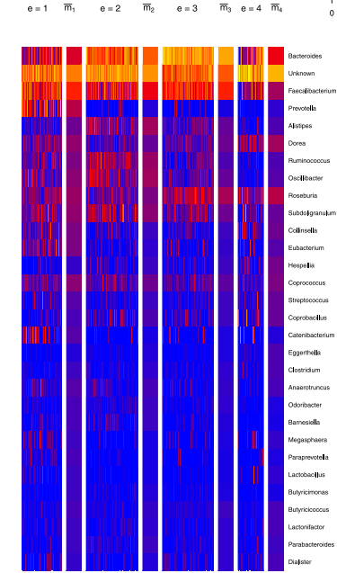
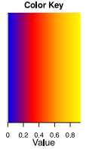
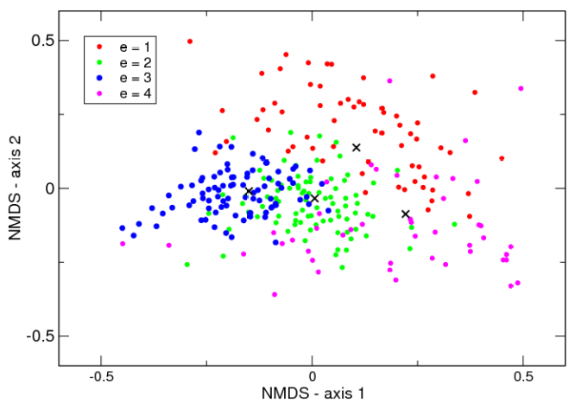
Holmes I et al. PLoS One 2012.

Slide 50
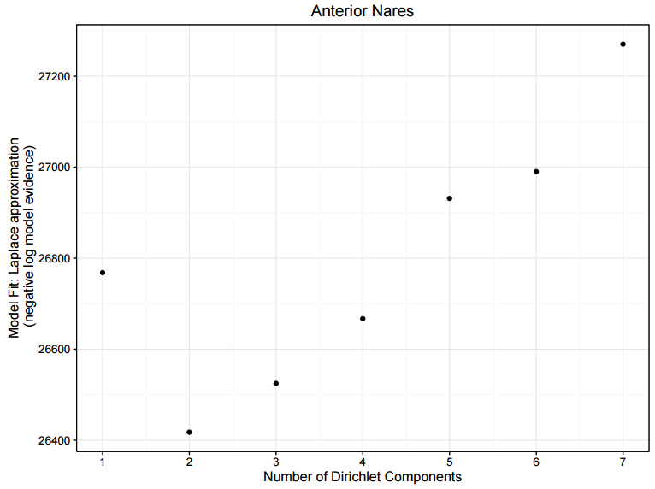
Kelly et al. ASM Microbe 2016.

Slide 51
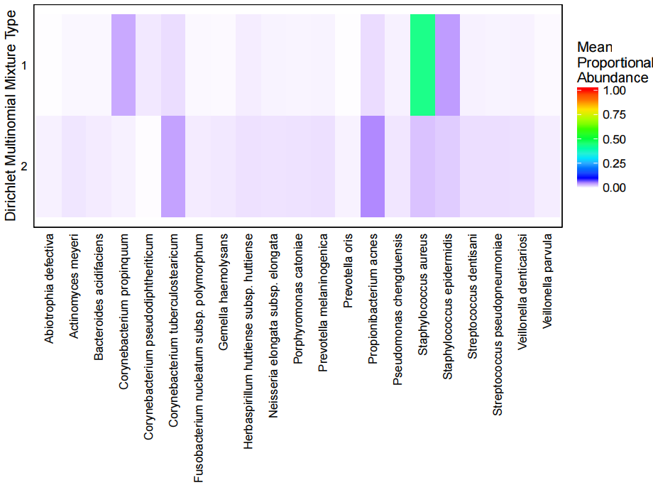
Kelly et al. ASM Microbe 2016.

Slide 52
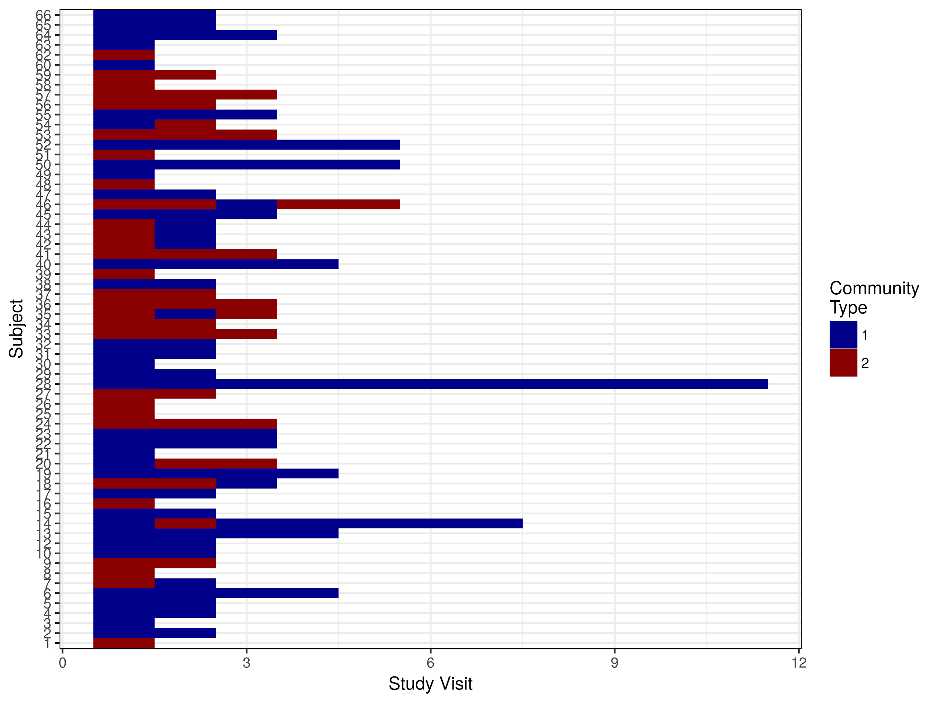

Slide 53

Ding &Schloss Nature 2014.

Slide 54
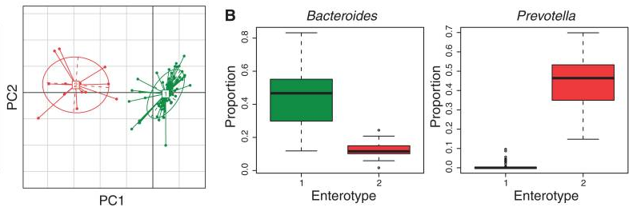
Wu et al Science 2011.

Slide 55
Methods for Microbiome Data
Visualization: heatmaps and barplots.
Single-taxon hypothesis.
Alpha diversity: richness and evenness.
Pairwise distances: count/phylogeny, weighted/unweighted.
Ordination: PCA & PCoA.
PERMANOVA: categorical exposure & microbiome outcome (allows quantification of effect size)
DMM models: unsupervised clustering > “community types” (identify relationships among variables/OTUs)

Slide 56
Conclusions
Distance-based analysis and adonis/PERMANOVA testing:
microbiome outcome measures
omega2 to define effect size of exposure/intervention
power estimation
Dirichlet-multinomial mixtures:
categorical analysis may correspond with biologic community types
identify key species
discovery / validation design

